Slide 1

Devnet Certification Study Group
A League of Extraordinary Engineers

Slide 2

Purpose
Create a cohort of interested engineers to blaze the trail to certification success
Leverage herd mentality
Drive engagement, encourage accountability
Foster team growth

Slide 3
Structure
Pacific (PST/PDT) / AZ Summer (MST) | Mountain (MST/MDT) / AZ Winter (MST) | Central | Eastern
10:00 AM | 11:00 AM | 12:00 PM | 1:00 PM
Weekly, 11am MST (GMT-7)
Note timezone changes
Weekly challenge, review on weekly call
Alternating presenters for review,
1) Visbility, cross functional give back
2) immersion, you will retain that subject best when forced to retell the message
Kickoff 2/28.
Depending on size of group, each Member, will be asked to contribute 2-5 questions for review (in quizlet). We will create our own internal study test.

Slide 4
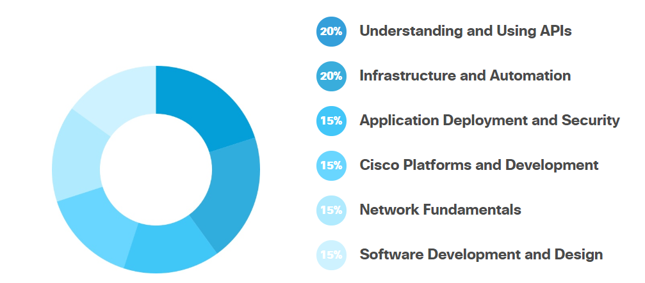
Knowledge domains
https://developer.cisco.com/certification/devnet-associate/

Slide 5
Syllabus/Logistics
Date | Topic | Presenter/moderator
2/28 | Kickoff – Dev environment, Github | Wnellis
3/20 | Module 1 – 1.1-1.8 | TBD
3/27 | Module 2 : 2.1-2.9
4/3 | Module 3.1 – 3.5
4/10 | Mod 3.6+
4/17 | Mod 4.1-4.5
4/24 | 4.7 – 4.12
5/1 | 5.X
5/8 | 5.x2
5/15 | TEST DAY
Tools:
Teams room (to be created)
Quizlet (wnellis to create class)
Friday meeting
Devnet Curriculum

Slide 6
Mod 1

Slide 7
Quizlet/ Teams Space
https://quizlet.com/join/jHjt92pgt - join my class
https://eurl.io/#S1CD38ZCr Join the webex teams space

Slide 8
First part of training
What is a Development Environment and why do you need one?
A brief introduction to Git
Intro to Python Part 1
Intro to Python Part 2
Coding 202: Parsing JSON using Python
Introduction to XML
Introduction to the Guest Shell

